Slide 1
What is Desired State Configuration and how does it help me?
Richard Fennell
Engineering Director Black Marble Ltd.
Microsoft MVP (Visual Studio ALM)

Slide 2
What is Desired State Configuration?

Slide 3


We all have an install process
Setup process
Find the installation media
Install the operating system with standard settings
Run the installer
Do next step……
Follow the process
Notes:
Everyone has Word document for setup, but…
Is it right?
Was it actual what was done?
You can use scripts, but they are time consuming to maintain
Key to quality is consistancy

Slide 4
Robustness as Consistency
“Taguchi argues that quality robustness stems from consistency.
Even if it means a product falls outside standard tolerances, as long as it does so consistently, then it is much easier to adjust machinery to attain precise targets.”
Taguchi, G. and D. Clausing. 1990. Robust quality. Harvard Business Review (Jan-Feb): 65-75.

Slide 5
So what is Desired State Configuration?
Microsoft’s implementation of the “Management Object Format,” as developed by the Distributed Management Task Force (DMTF).
Provides configuration as code
Part of PowerShell 4.0
Aims for ‘Star Trek’ deployment
Notes:
As in PowerShell 4 it is ‘baked into Windows’
Provides configuration as code, so gain all the benefits of code
The configuration file that goes to a managed node is a static MOF file. That’s a plain-text file, as in “Management Object Format,” as in developed by the Distributed Management Task Force (DMTF). A vendor-neutral standard, in other words
http://www.dmtf.org/
Treat configuration files as first-class citizens
Put your configuration files under source control
Use configuration files to describe end states
Test your configurations
Use a pull server as a single point-of-truth
Don't make manual changes to machines
Consider rollback scenarios

Slide 6
Operating Systems Support
By default
Windows 8.1
Windows Server 2012 R2
Install Windows Management Framework 4.0
Windows® 7 with Service Pack 1
Windows Server® 2008 R2 with Service Pack 1

Slide 7
Demo – DSC 101
Notes:
Deploy a web site

Slide 8
Configuration MyWebConfig
{
# A Configuration block can have zero or more Node blocks
Node "WIN-63Q8385RMVR"
{
# Next, specify one or more resource blocks
# WindowsFeature is one of the built-in resources you can use in a Node block
# This example ensures the Web Server (IIS) role is installed
WindowsFeature MyRoleExample
{
Ensure = "Present" # To uninstall the role, set Ensure to "Absent"
Name = "Web-Server"
}
# File is a built-in resource you can use to manage files and directories
# This example ensures files from the source directory are present in the destination directory
File MyFileExample
{
Ensure = "Present" # You can also set Ensure to "Absent"
Type = "Directory“ # Default is “File”
Recurse = $true
SourcePath = "c:\src" # This is a path that has web files
DestinationPath = "C:\inetpub\wwwroot" # The path where we want to ensure the web files are present
DependsOn = "[WindowsFeature]MyRoleExample" # This ensures that MyRoleExample completes successfully before this block runs
}
}
}
Notes:
We have an newly installed Win2012R2, running in non-UI mode
Create a test page C:\src\default.htm
Save the above as dsc.ps1 file
Run PowerShell
Import the file . .\dsc.ps1
Run MyWebConfig, it generates a MOF, note the name is that of the machine
Start-DscConfiguration -Wait -Verbose -Path .\MyWebConfig
Takes a while, you should be able to browse http://169.254.79.78/
Delete default.htm and try to browse again, it will fail
Rerun the config and it is fixed – DSC can stop drift

Slide 9
Sample Configuration
$MyData =
@{
AllNodes =
@(
@{
NodeName = "*"
LogPath = "C:\Logs"
},
@{
NodeName = "VM-1";
Role = "WebServer"
SiteContents = "C:\Site1"
SiteName = "Website1"
},
@{
NodeName = "VM-2";
Role = "SQLServer"
},
@{
NodeName = "VM-3";
Role = "WebServer";
SiteContents = "C:\Site2"
SiteName = "Website3"
}
);
NonNodeData =
@{
ConfigFileContents = (Get-Content C:\Template\Config.xml)
}
}
configuration MyConfiguration
{
Import-DscResource -ModuleName xWebAdministration -Name MSFT_xWebsite
node $AllNodes.Where{$_.Role -eq "WebServer"}.NodeName
{
xWebsite Site
{
Name = $Node.SiteName
PhysicalPath = $Node.SiteContents
Ensure = "Present"
}
File ConfigFile
{
DestinationPath = $Node.SiteContents + "\\config.xml"
Contents = $ConfigurationData.NonNodeData.ConfigFileContents
}
}
}
MyConfiguration -ConfigurationData $MyData
Notes:
A more complex sample
To specify the environmental part of the configuration, DSC uses the ConfigurationData parameter, which is a hash table (or it can take a .psd1 file which contains the hash table). This hash table must have at least one key AllNodes, which has a structured value.
Note the AllNodes key, whose value is an array. Each element of this array is also a hash table, which requires NodeName as a key:
DSC offers three special variables to use in the configuration script:
$AllNodes Refers to all of the nodes. You can use filtering with .Where() and .ForEach(), so instead of hard-coding node names to select particular nodes for action, you could write something like this to select VM-1 and VM-3 in the above example:
$Node Once the set of nodes is filtered, you can use $Node to refer to the particular entry
$ConfigurationData You can use this variable inside a configuration to access the configuration data hash table passed as a parameter

Slide 10
DSC Resource names explained
[CompanyNamePrefix]_[prefix][ResourceName]
Where,
CompanyNamePrefix is the prefix for your company.
Prefix is an optional prefix you would want to give your resource to indicate whether it is experimental (x) or community (c).
ResourceName is the name of your resource. The resource name must be noun and ideally the resource that you are looking to configure.
Example: MSFT_xIPAddress, VSAR_cSample
Notes:
Good way to think of modules resources is as a noun with verb actions

Slide 11
You don’t have to push
Pull Server
Pull Client 1
Get Config
LCM
Send Config
DSC OData Endpoint
Pull Client 2
Get Config
IIS Server
LCM
Send Config
Configurations
Pull Client 3
Get Config
Resources
LCM
Send Config

Slide 12
How do you create a DSC Pull Server?
You use DSC of course!
Configuration NewPullServer
{
param
(
[string[]]$ComputerName = ‘localhost’
)
Import-DSCResource -ModuleName xPSDesiredStateConfiguration
Node $ComputerName
{
WindowsFeature DSCServiceFeature
{
Ensure = “Present”
Name = “DSC-Service”
}
xDscWebService PSDSCPullServer
{
Ensure = “Present”
. . .

Slide 13
Write a configuration to pull
Configuration ContosoWebsite
{
param ($MachineName)
Node $MachineName
{
#Install the IIS Role
WindowsFeature IIS
{
Ensure = “Present”
Name = “Web-Server”
}
#Install ASP.NET 4.5
WindowsFeature ASP
{
Ensure = “Present”
Name = “Web-Asp-Net45”
}
}
}
ContosoWebsite –MachineName “server2.contoso.com”

Slide 14
Rename the MOF with a GUID on server
$Guid= [guid]::NewGuid()
$source = “ContosoWebsite\server2.contoso.com.mof”
$target= “\\server1\c$\program files\windowspowershell\dscservice\configuration\$Guid.mof”
copy $source $target

Slide 15
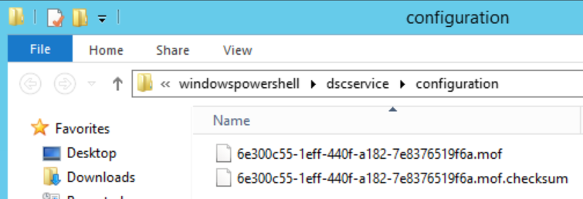
Generate a checksum
$target= “\\server1\c$\program files\windowspowershell\dscservice\configuration\$Guid.mof”
New-DSCChecksum $target

Slide 16
Configure the client LCM
Configuration SetPullMode
{
param([string]$guid)
Node server2.contoso.com
{
LocalConfigurationManager
{
ConfigurationMode = ‘ApplyOnly’
ConfigurationID = $guid
RefreshMode = ‘Pull’
DownloadManagerName = ‘WebDownloadManager’
DownloadManagerCustomData = @{
ServerUrl = ‘http://server1:8080/PSDSCPullServer.svc';
AllowUnsecureConnection = ‘true’ }
}
}
}
SetPullMode –guid $Guid
Set-DSCLocalConfigurationManager –Computer server2.contoso.com -Path ./SetPullMode –Verbose

Slide 17
Demo – DSC Pull Server
Notes:
If doing one base on http://www.systemcentercentral.com/day-1-intro-to-powershell-dsc-and-configuring-your-first-pull-server/

Slide 18
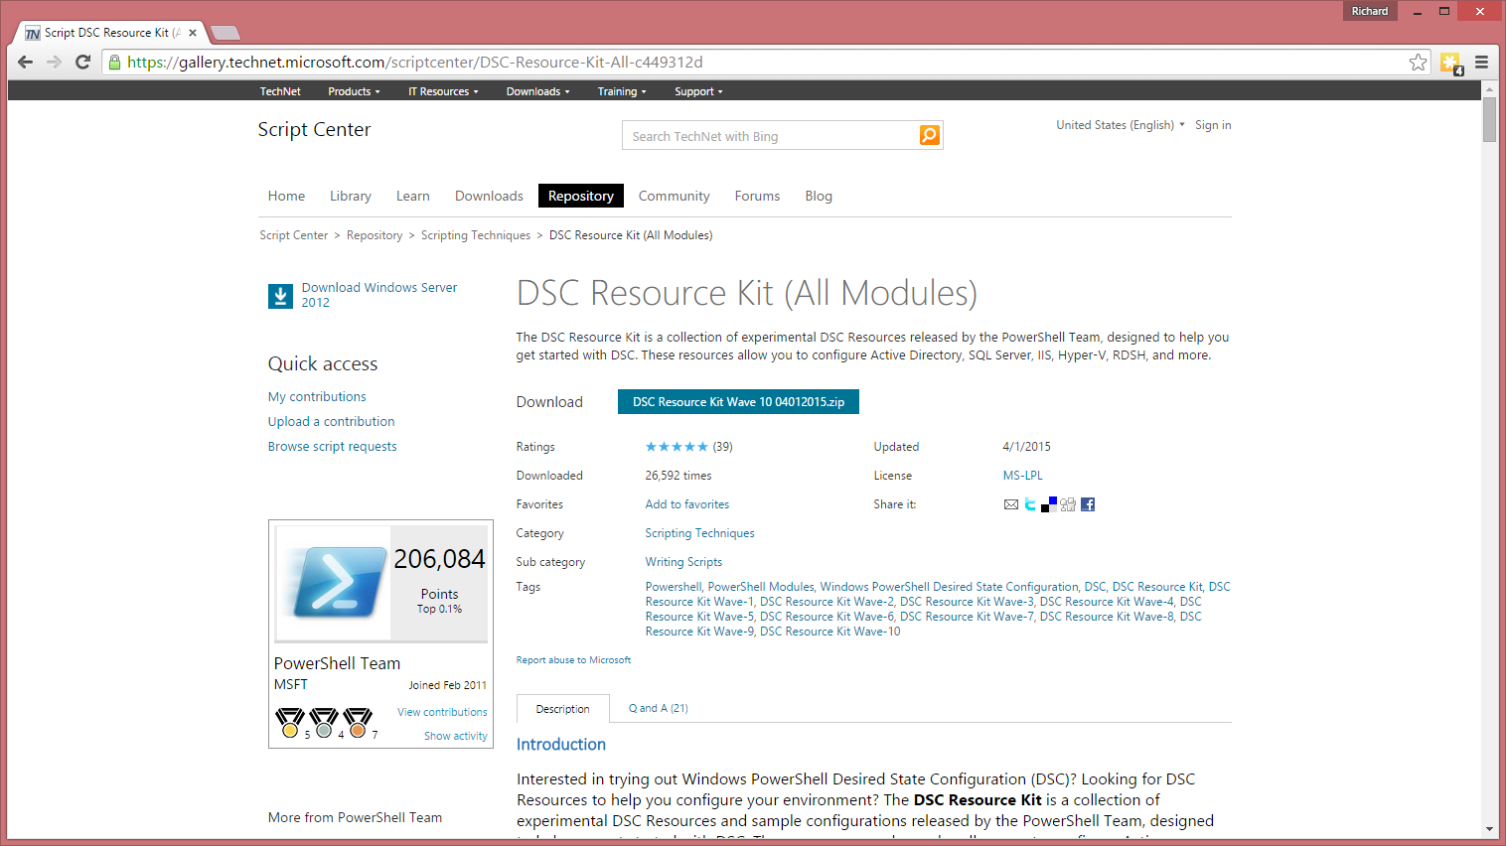
Where to find module resources - today

Slide 19
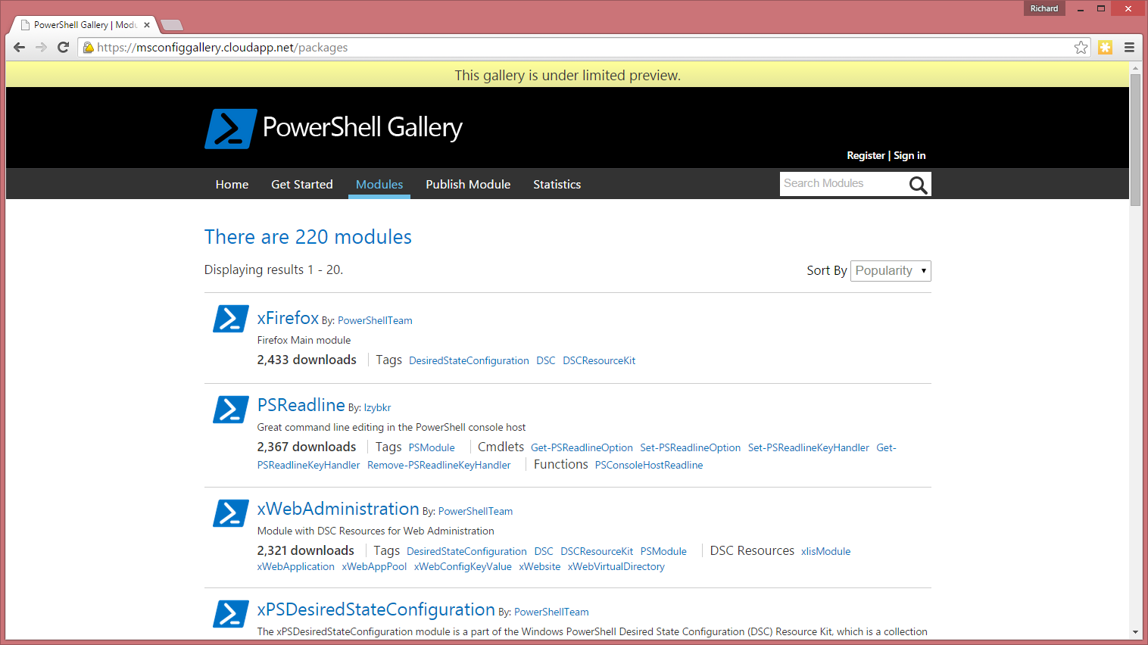
Where to find module resources - future
Notes:
Based on NuGet, and can leverage public repositories such as Chocolatey or private ones
Think an ITPro repository
PowerShell 5 includes OneGet
Based on NuGet
Single source for packages
Can be public or private
PowerShellGet
Layered on OneGet
Specificially for DSC modules
CTP used https://msconfiggallery.cloudapp.net/packages

Slide 20
Writing Modules & Resources

Slide 21
Writing a DSC Resources
Get-TargetResource
Set-TargetResource
Test-TargetResource
Notes:
3 methods
Experience shows the hard bit the working out the correct state
Get-TargetResource – This method should receive the keys of the resource and return a hash table with all the resource properties as configured on the system.
Test-TargetResource – This method receives the keys and properties (as defined in the schema) and checks if the current configuration for the resource exists in the system. If any of the property values do not match the resource instance, $false should be returned and $true otherwise.
Set-TargetResource - This method will called to guarantee the resource instance matches the property values. This method must be idempotent and after it is executed, it must ensure the resource instance is exactly as defined. It needs to be able to create a resource from scratch or to make some changes to an existing resource to make sure its state matches the state defined in the configuration Would be useful to descript what each script does. Perhaps an example would be useful as well.

Slide 22
Generating the initial outline
#This creates the definition for the resource
#The share to create
$ShareName = New-xDscResourceProperty -Name ShareName -Type String -Attribute Key
#The path where the folder that maps to the share should be created
$Path = New-xDscResourceProperty -Name Path -Type String -Attribute Required
#Identify if the action is to create the share or remove the share (i.e. should it be present or absent)
$Ensure = New-xDscResourceProperty -Name Ensure -Type String -Attribute Write -ValidateSet "Present", "Absent"
#An array of users who should have full access
$FullAccessUsers = New-xDscResourceProperty -Name FullAccessUsers -Type String[] -Attribute Write
#Create the actual resource
New-xDscResource -Name VSAR_cCreateFileShare -Property $ShareName, $Path, $Ensure -Path 'C:\Program Files\WindowsPowerShell\Modules\VSAR_cFileShare' -FriendlyName VSAR_cCreateFileShare

Slide 23
Generating the initial outline
WARNING
xDscResourceDesigner should have output one additional file named VSAR_cFileShare.psd1 in the VSAR_cFileShare folder.
To generate this, execute the following PowerShell command:
New-ModuleManifest –Path “C:\Program Files\WindowsPowerShell\Modules\VSAR_cFileShare\VSAR_cFileShare.psd1”
WindowsPowerShell (folder)
Modules (folder)
VSAR_cFileShare (folder)
DSCResources (folder)
VSAR_cCreateFileShare (folder)
VSAR_cCreateFileShare.psm1 (file)
VSAR_cCreateFileShare.schema.mof (file)

Slide 24
Implement Get-TargetResource
function Get-TargetResource
{
[CmdletBinding()]
[OutputType([System.Collections.Hashtable])]
param
(
[parameter(Mandatory = $true)]
[System.String]
$ShareName,
[parameter(Mandatory = $true)]
[System.String]
$Path
)
#Temporary variable to store the results of the file share check
$shareInfo = $null
Write-Verbose -Message "Checking if the file share $ShareName exists..."
#If the share exists, it will return an object
$shareInfo = Get-SmbShare $ShareName -ErrorAction SilentlyContinue
if ($shareInfo)
{
Write-Verbose -Message "File share exists."
#If no exception, then the share exists
$ensureResult = "Present"
}
else
{
Write-Verbose -Message "File share does not exist."
#The share doesn't exist
$ensureResult = "Absent"
}
Write-Verbose -Message "Creating hashtable."
$returnValue = @{
ShareName = $ShareName
Path = $Path
Ensure = $ensureResult
}
$returnValue
}

Slide 25
Implement Set-TargetResource
function Set-TargetResource
{
[CmdletBinding()]
param
(
[parameter(Mandatory = $true)]
[System.String]
$ShareName,
[parameter(Mandatory = $true)]
[System.String]
$Path,
[ValidateSet("Present","Absent")]
[System.String]
$Ensure
)
if($Ensure -eq "Present")
{
#Add the share
Write-Verbose -Message "Creating the file share"
Write-Verbose -Message "Checking to see if the path exists"
#Check to see if the path exists
$PathExists = Test-Path -Path $Path
if (!$PathExists)
{
Write-Verbose "The path does not exist"
Write-Verbose "Creating the path..."
#Create the folder because it doesn't exist
New-Item -Path $Path -ItemType directory
}
Write-Verbose -Message "Creating the share"
#Create the share
New-SmbShare -Name $ShareName -Path $Path
}
else
{
Write-Verbose -Message "Removing the file share"
#Remove the share
Remove-SmbShare -Name $ShareName -Force
}
}

Slide 26
Implement Test-TargetResource
function Test-TargetResource
{
[CmdletBinding()]
[OutputType([System.Boolean])]
param
(
[parameter(Mandatory = $true)]
[System.String]
$ShareName,
[parameter(Mandatory = $true)]
[System.String]
$Path,
[ValidateSet("Present","Absent")]
[System.String]
$Ensure
)
Write-Verbose -Message "Configuration has requested the share be $Ensure"
#Initialize the return value variable
$returnValue = $false
if($Ensure -eq "Present")
Write-Verbose -Message "Checking file share $ShareName exists..."
$ShareInfo = Get-SmbShare -Name $ShareName -ErrorAction SilentlyContinue
if ($ShareInfo)
{
Write-Verbose -Message "Share exists."
$returnValue = $true
} else {
Write-Verbose -Message "Share does not exist."
$returnValue = $false
}
} else {
Write-Verbose -Message "Checking the file share $ShareName exists..."
$ShareInfo = Get-SmbShare -Name $ShareName -ErrorAction SilentlyContinue
if ($ShareInfo)
{
Write-Verbose -Message "Share exists."
$returnValue = $false
} else {
Write-Verbose -Message "Share does not exist."
$returnValue = $true
}
}
$returnValue
}

Slide 27
Unit test the resource
#Unit tests for VSAR_cCreateFileShare
Import-Module "C:\Program Files\WindowsPowerShell\Modules\VSAR_cFileShare\DSCResources\VSAR_cCreateFileShare"
#Variable Declarations
$ShareName = "TestShare"
$Path = "C:\Test"
$PassCounter = 0
$FailCounter = 0
$SetupResult = Get-SmbShare -Name $ShareName -ErrorAction SilentlyContinue
if (!$SetupResult)
{
New-SmbShare -Path $Path -Name $ShareName
}
$Result = Get-TargetResource -ShareName $ShareName -Path $Path
if ($Result.Ensure -ne "Present")
{
$FailCounter += 1
"Test 1 Failed"
}
else
{
$PassCounter += 1
"Test 1 Passed"
}

Slide 28
Use the resource
Configuration CreateDropShare
{
Import-DscResource -ModuleName VSAR_cFileShare
Node appserver
{
VSAR_cCreateFileShare CreateShare
{
ShareName = 'DropShare'
Path = 'C:\DropShare'
Ensure = 'Present'
}
}
}
CreateDropShare

Slide 29
Tips for DSC resource development
Treat configuration files as first-class citizens
Use configuration files to describe end states, don't make manual changes to machines
Use a pull server as a single point-of-truth
Test your configurations
Watch the operational event log for problems
Consider rollback scenarios

Slide 30
Processes pinned in memory
Kill the WMI provider host that is hosting your PowerShell or PowerShell ISE window
-or-
Create and run a script to unload cached modules
# Check that the required powershell module is loaded if it is remove it as it might be an older version
if ((get-module -name BlackMarble.Tfs.Utilities ) -ne $null)
{
remove-module BlackMarble.Tfs.Utilities
}
$folder = Split-Path -parent $MyInvocation.MyCommand.Definition
import-module $folder\BlackMarble.Tfs.Utilities.psd1 –verbose

Slide 31
Demo – Creating a resource

Slide 32
The Future

Slide 33
Open Management Infrastructure
Provides standards-based management for
Cloud management
Storage management
Server hardware management
Device management
Network management
https://collaboration.opengroup.org/omi/

Slide 34
DSC on Linux
Uses OMI as opposed to WMI
So can use WS-Management protocol
Uses Python under the covers
Source is all on GitHub
It is not going to convert the Linux world
But can extend the reach of DSC for the Windows admin
Notes:
http://blogs.technet.com/b/privatecloud/archive/2014/05/19/powershell-dsc-for-linux-step-by-step.aspx
Not going to convert the world to DCS, but allow Windows admins to manage Linux in a similar format

Slide 35
Demo – DSC on Linux

Slide 36
Is DSC a competitor to Chef, Puppet etc?
No
Puppet & Chef each provide a complete solution stack
These tools work really well, but came from Unix world where configuration is ‘easier’
DSC only provides the platform-level implementation
But Chef/Puppet can call DSC, they can play nice together, so it can extend their reach on Windows
Notes:
http://powershell.org/wp/2014/05/14/why-puppet-vs-dsc-isnt-even-a-thing/comment-page-1/

Slide 37
DSC at the core of Microsoft’s DevOps
DSC modules appearing for most Windows systems, including Azure
But it is a new technology, can be ‘flaky’
A technology to keep an eye on…

Slide 38
Resources
TechEd 2014, A Practical Overview of Desired State Configuration
http://channel9.msdn.com/Events/TechEd/NorthAmerica/2014/DCIM-B417
PowerShell DSC Forum
http://powershell.org/wp/forums/forum/dsc-desired-state-configuration
Windows PowerShell Blog
http://blogs.msdn.com/b/powershell/
DSC Resource Kit (Wave 6)
http://gallery.technet.microsoft.com/DSC-Resource-Kit-All-c449312d
Community Resources
https://github.com/powershellorg/dsc
ALM Rangers ‘Configuration as Code’
https://vsardevops.codeplex.com/

Slide 39
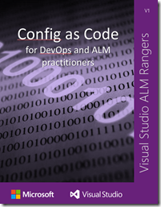
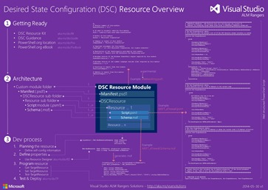
ALM Rangers
https://vsardevops.codeplex.com/
Notes:
Worked example of installing TFS

Slide 40
Contact
richard@blackmarble.com
@richardfennell
http://blogs.blackmarble.co.uk/blogs/rfennell

